Slide 1

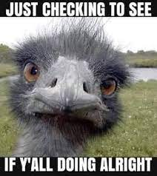
LEADING Boot camp
Monday, June 13, 2022
1:00 PM-2:15 PM EDT/10:00 AM-12:15 PM PDT
Agenda:
How’s everyone doing
Big metadata (brief comments)
Ontology/briefly linked data
~ Protégé
4. Other/open discussion

Slide 2
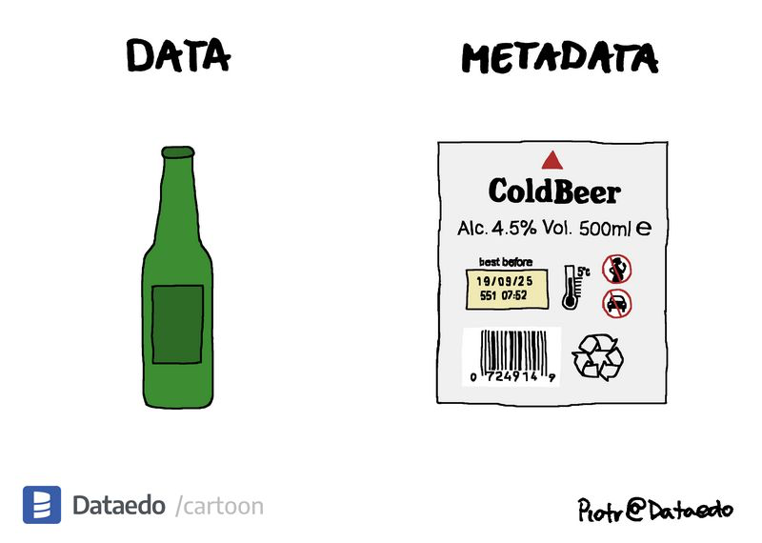
What is Metadata?
Data about data, info. about information… blah blah blah
Data that makes other data/information objects useful.
Data supporting one or more function/action (discovery, authenticity, preservation, linking, provenance tracking…)
Metadata is a first-class data object
There’s lots of unstructured data, but…. a lot of data has metadata or needs better metadata to use it.

Slide 3
Research Data Alliance Conference
Peter Fox, RDA, Sweden, 2014
Let’s get rid of the word metadata

Slide 4
Components of Metadata Standards
Data structure Standards (container, label, semantics) | Data communication standards (encoding, markup, data exchange) | Data value standards (authority files, ontologies, taxonomies, etc.)
Data syntax standards | Data syntax standards
element/property ordering | think grammar… | content syntax

Slide 5
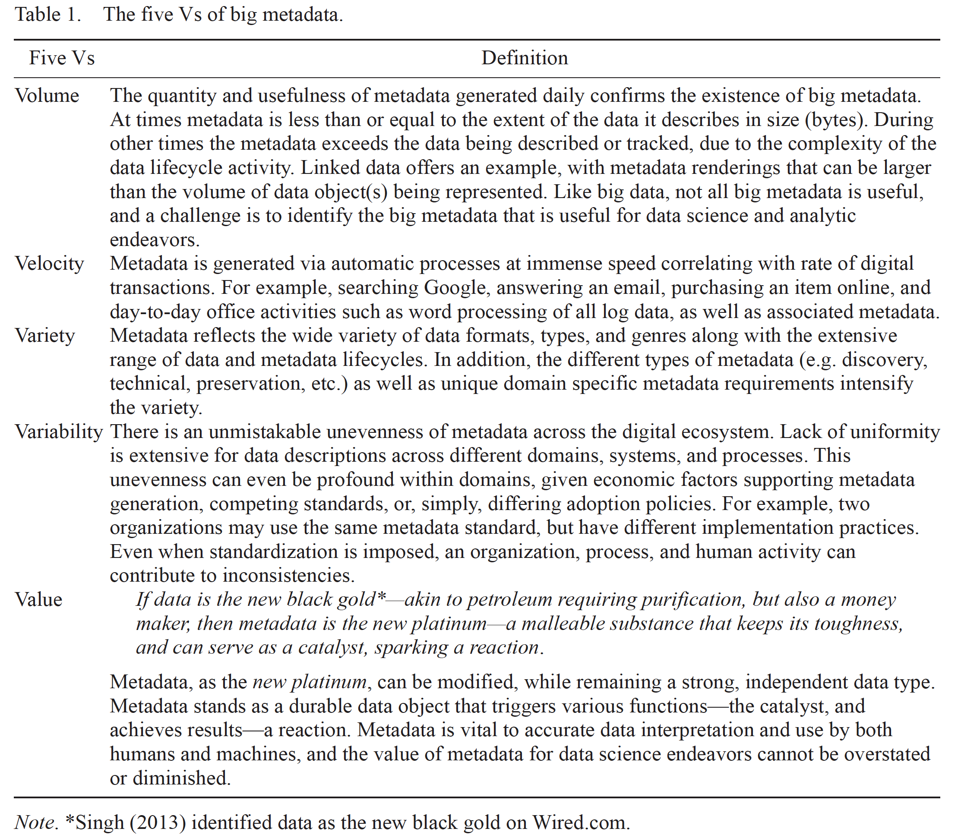
Big Metadata
Greenberg, J. (2017): doi.org/10.1515/jdis-2017-0012

Slide 6

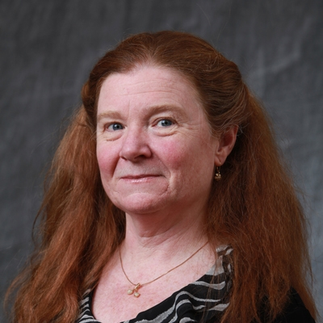
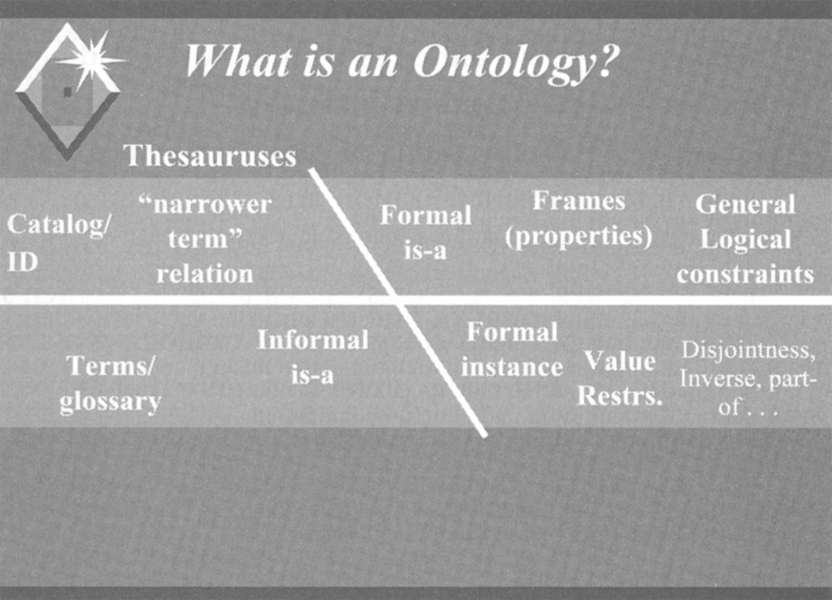
(McGuinness, D. L. (2003). Ontologies Come of Age. In Fensel, et al, Spinning the Semantic Web. (Cambridge, MIT Press)
Ontology

Slide 7
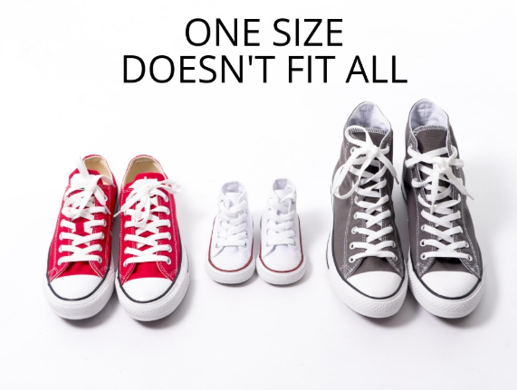

Ontologies and reality

Slide 8
Zeng, Marcia Lei. 2008. “Knowledge Organization Systems”. Knowledge Organization 35, nos. 2-3: 160-82.

Slide 9
Philosophy
Dates back to 5th Century B.C. when Empedocles divided the world into four elements – earth, fire, water and air.
Aristotle ∙ classification
Touches on “epistemology,” which” is about knowledge and knowing
Metaphysics: Defined by philosophers as the nature of being or existence.

Slide 10

Ontology defined
Other important
stuff
(comfy space)
No exact definition
Generally speaking - ontology is a WAY to convey a theory on how to represent a class of things and their relationships
Knowledge representation, Knowledge organization (ILS)
Blurry lines – w/database structure and knowledge graphs
Webster’s dictionary
A science or study of being specifically, a branch of metaphysics relating to the nature and relations of being.
A theory concerning the kinds of entities and specifically the kinds of abstract entities that are to be admitted to a language system.
Thomas Gruber
“An ontology is a specification of a conceptualization”
A must read!

Slide 11
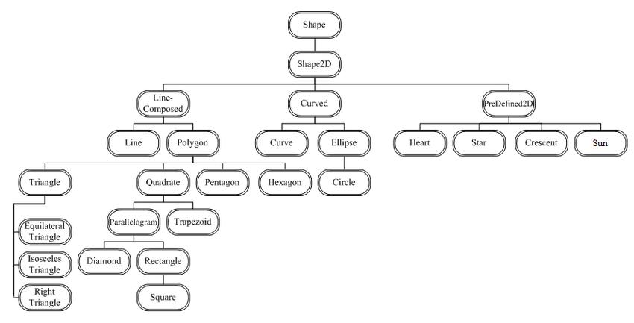
AN ONTOLOGY OF SHAPES
http://ceur-ws.org/Vol-812/paper9.pdf

Slide 12
Ontology
National Center for Biological Ontologies: https://bioportal.bioontology.org/
Example of a
Film ontology→

Slide 13
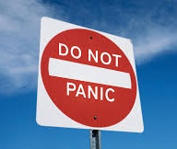
Most ontologies structured as taxonomies, hierarchies
People talk about ontologies in many, many, many… ways
Basic ontology has two classes of elements: the entities and the relationships between them
Class and sub-classes: Actor, Child actor
Relationships
Is a type of
Movie “is directed by” director
Movie “has performance” actor
This is more involved than a lexical-semantic thesaurus.
More involved / RDF triples
Predicate (has a property of X)
E.g., Book has title
predicates are linguistic entities
Subject-predicate-object (think reverse ABC)
Organized according to axioms or rules that control how the world will be defined.

Slide 14
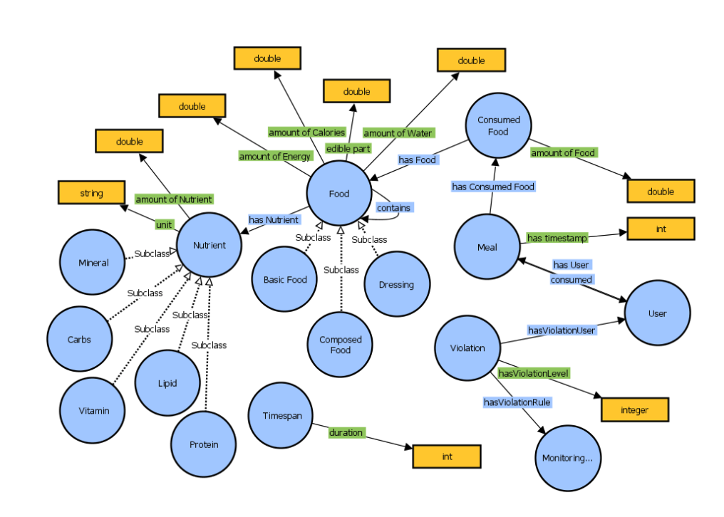
AN ONTOLOGY OF FOOD
https://www.w3.org/community/owled/files/2016/11/OWLED-ORE-2016_paper_3.pdf

Slide 15

Let’s go to Protégé
We will work with OWL: Web Ontology Language: https://www.w3.org/OWL/
Modeling language
Enabling technology
SKOS – Simple Knowledge Organization System: https://www.w3.org/2004/02/skos/

Slide 16


Important Facts
What exists is only what is represented in the ontology
Most ontologies focus on a specific area to conceptualize the world.
Must be updated to keep up with dynamic world
No set discipline or methodology!
Joined together with instances, get closer toward knowledge graph... but fuzzy line

Slide 17
The Role of Ontology
Indexing, browsing, finding, visualizing…
Application areas
Indexing
Knowledge Sharing & Reuse
Artificial Intelligence (AI)
Enterprise Modeling
Software Design
Molecular Biology
eCommerce
Semantic Web….
A language, reliable sharing of information
Enable reuse of domain knowledge
Makes assumptions more explicit
Analyze domain knowledge
Reasoning

Slide 18
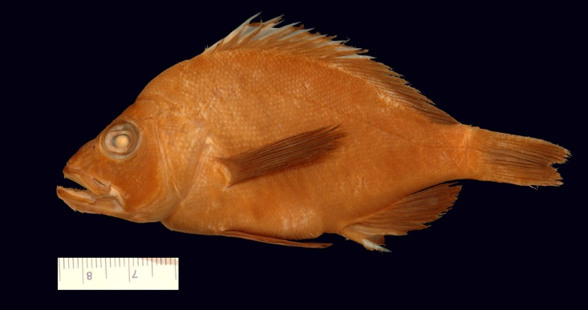
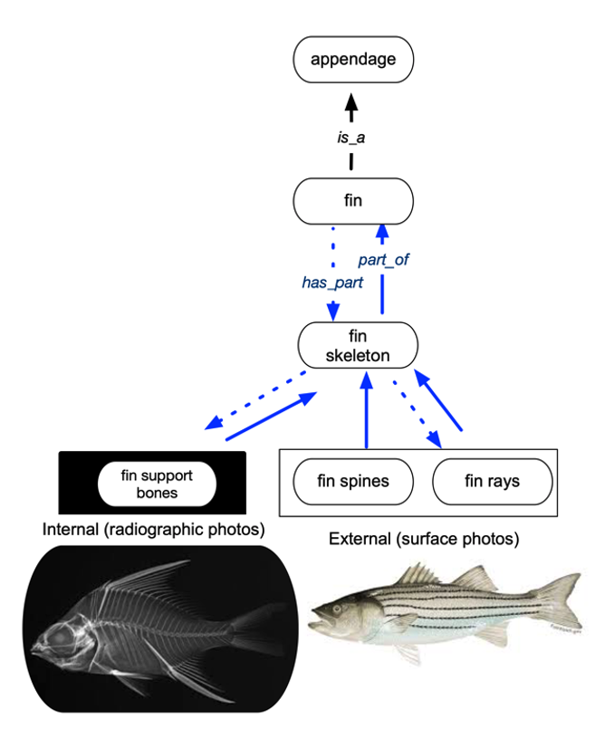
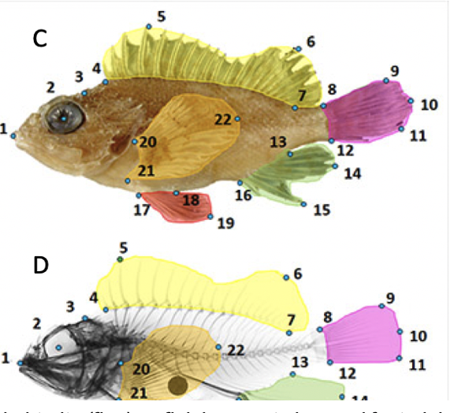
Reasoning to identify species variation
NSF-HDR Biology Guided Neural Networks (BGNN)

Slide 19
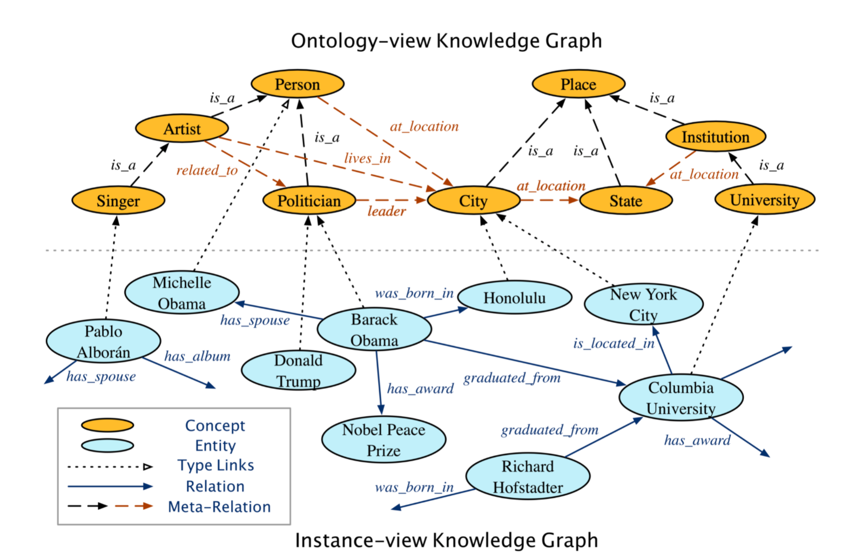

https://www.haojunheng.com/project/joie-kdd/

Slide 20

Linked data
Strings and things
Semantic Web vision
Everything should have a unique ID, in fact a Persistent ID (PID)

Slide 21
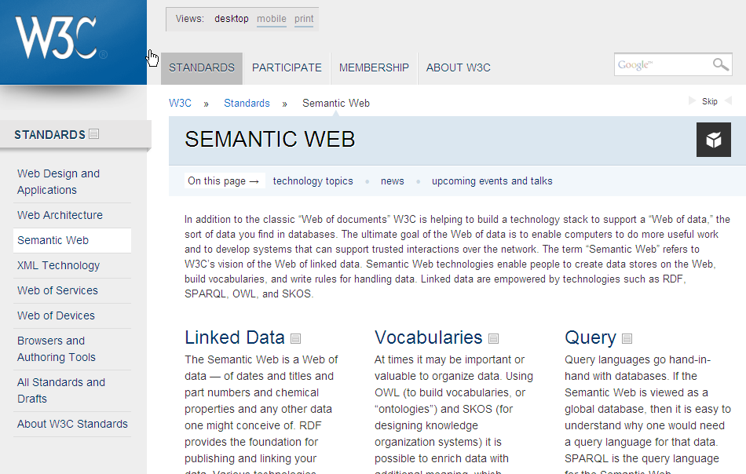
Evolution of the Web http://www.w3.org

Slide 22
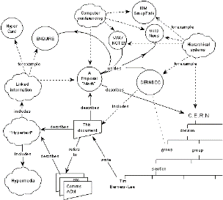
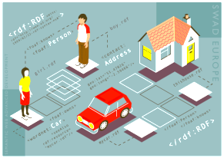
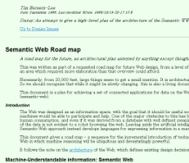

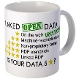
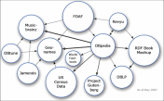



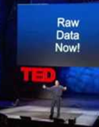
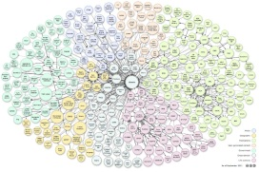
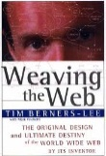









(E. Mendez, 2012)
March, 1989
Activity starts, 2001
Tim BL
LOD principles
FOAF
(Early 2000)
1st LOD Cloud
Cyganiak & Jentzsch (May2007)
Tim BL Roadmap on Semantic Web
(Sept1998)
FOAF Voc. Spec
(May2005)
Berners Lee, Hendler & Lassila (May2001)
Tim BL
Linked Data
(July2006)
OIL
DCMI Singapore
Framework
(Aug2007)
Tim BL TED Talks
(Feb 2009 &
Mar 2010)
Last LOD Cloud
Cyganiak & Jentzsch (Nov2011)
DAML
DCMES
(ISO-2003)
1998
2002
2006
2010
1996
2000
2004
2008
2012
PICS W3C-REC–Oct96
RDFS (RDF Schema)
1st Draft –1998
RDFS (RDF Schema)
W3C-CR, March1998
RDFS Vocabulary
Description Language
SKOS 1st Draft
(May2005)
W3C-REC Aug2009
Library Linked Data XG (May 2010)
Final Reports (Oct2011)
RDF Model & Syntax 1st Draft–Oct97
RDF M&S
W3C-REC, Feb2004
RDF M&S
W3C-REC, Oct99
W3C-REC, Jan2008
MCF Meta Content
Framework–Jun97
W3C Linked Data Platform LDP XG
(May2012)
OWL specifications
W3C-REC, Feb2004
OWL2 specifications
W3C-REC, Oct2009
In XHTML
W3C-REC, Oct2008

Slide 23
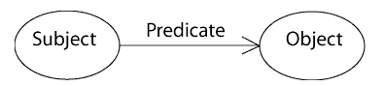
Linked Data based on RDF data model
Is similar to Entity-Relationship or Class diagrams, statements about resource in subject-predicate object expressions called “triples”.
subject= resource
predicate=traits or aspects of the resource and expresses a relationship between the subject and the object.
http://www.w3.org/TR/rdf-concepts/

Slide 24
The sky has the color blue
RDF triple:
A subject denoting “the sky”
A predicate denoting “has the color”
An object denoting “blue”

Slide 25
Example of RDF
<rdf:RDF xmlns:rdf="http://www.w3.org/1999/02/22-rdf-syntax-ns#"
xmlns:dc="http://purl.org/dc/elements/1.1/">
<rdf:Description rdf:about=”https://www.sciencemag.org/news/2020/07/during-pandemic-students-do-field-and-lab-work-without-leaving-home”>
<dc:title>During the pandemic, students do field...
</dc:title>
</rdf:Description>
</rdf>
https://www.sciencemag.org/news/2020/07/during-pandemic-students-do-field-and-lab-work-without-leaving-home
 | subject
 | predicate
 | object

Slide 26
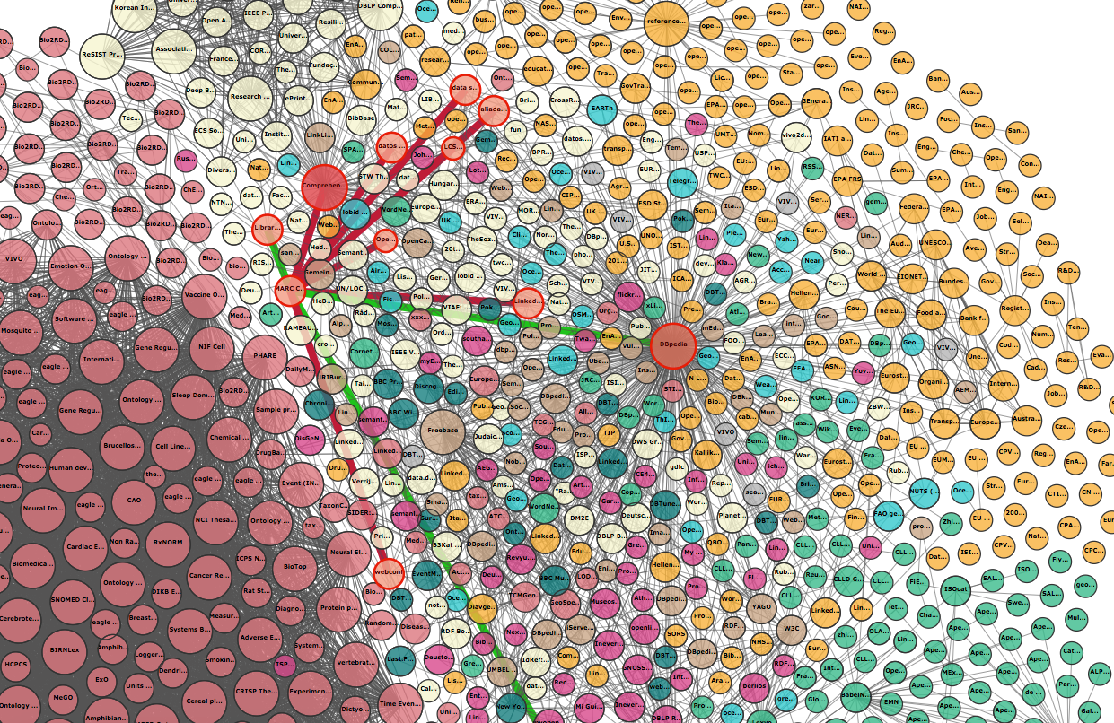
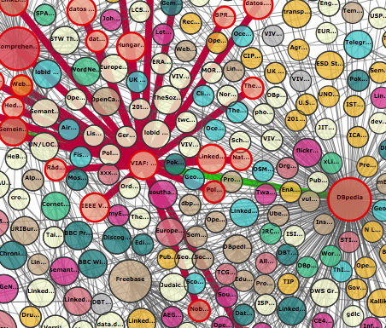
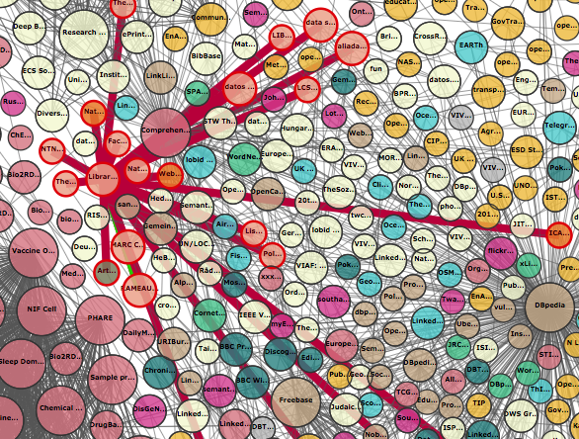
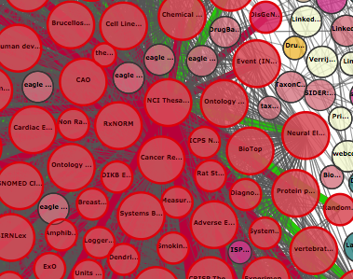
https://lod-cloud.net/

Slide 27
LCSH

Slide 28
Ontologies as “structured terminologies”
Relationships
Is at type of
Causes
Synonyms
An island “is a type of” land area
A nation “is a type of” geopolitical area
I am an ontologist
Dagobert Soergel, ACM/CL, 1997
http://nkos.slis.kent.edu/busch/summary.pdf

